Slide 1

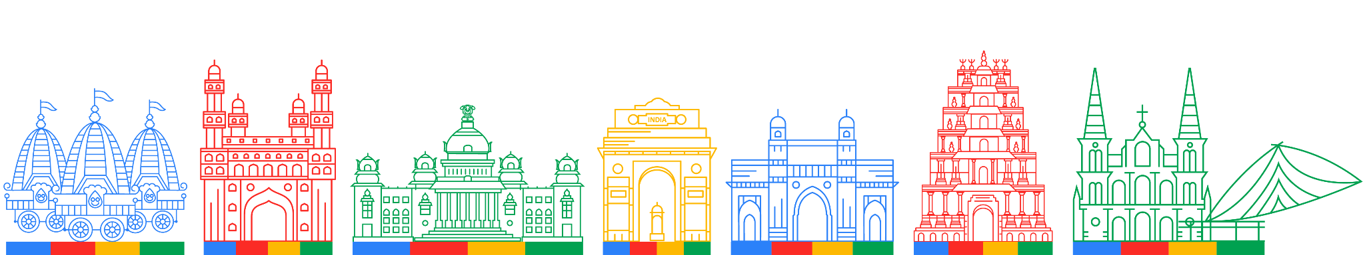
Cloud Community
Day 2024
Building Multimodal Search with Gemini Vision model and RAG
Rishiraj Acharya

Slide 2

$whoami
Google Developer Expert in ML (Gen AI, Keras)
Hugging Face Fellow 🤗
Google Summer of Code 2022 at TensorFlow
Kaggle Competitions Master
Machine Learning Engineer at Tensorlake
Organizer of TensorFlow User Group Kolkata

Slide 3
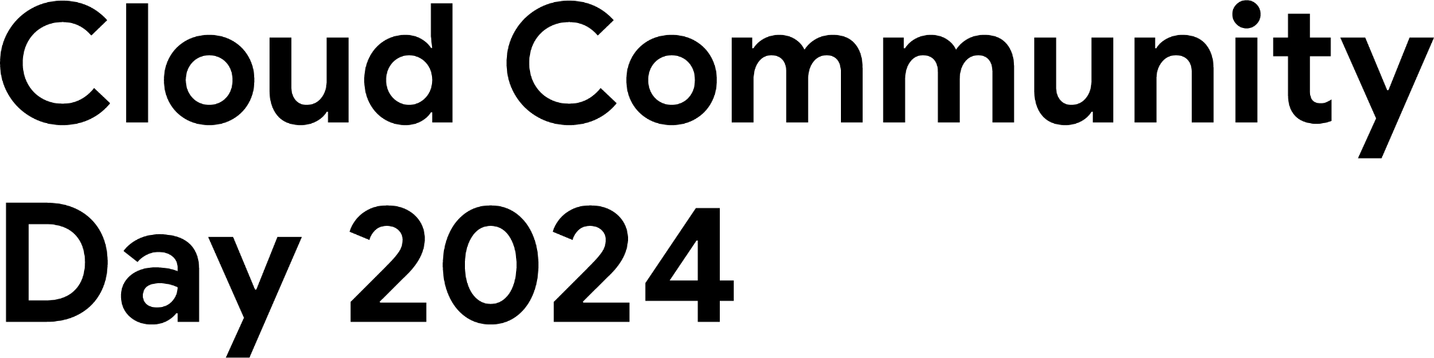
Why Multimodality?

Slide 4

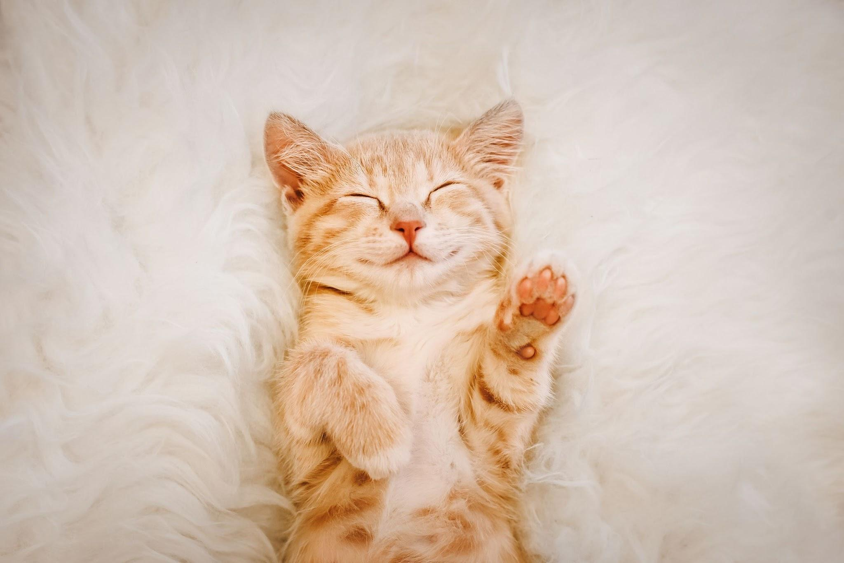
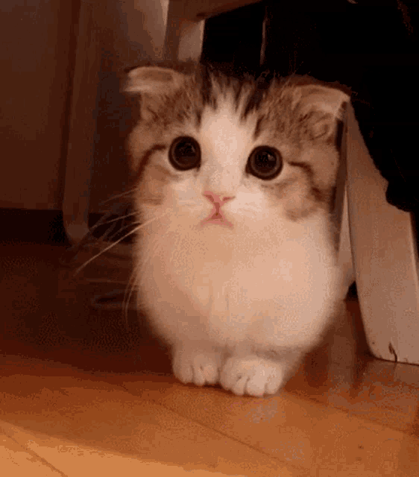
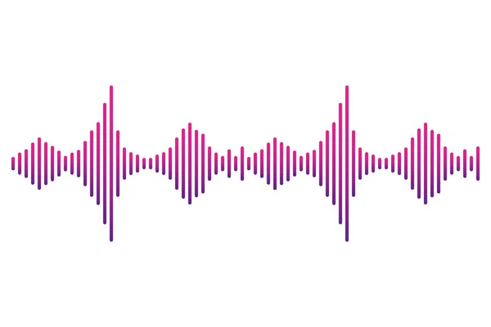
Cat is a cute pet animal.

Slide 5
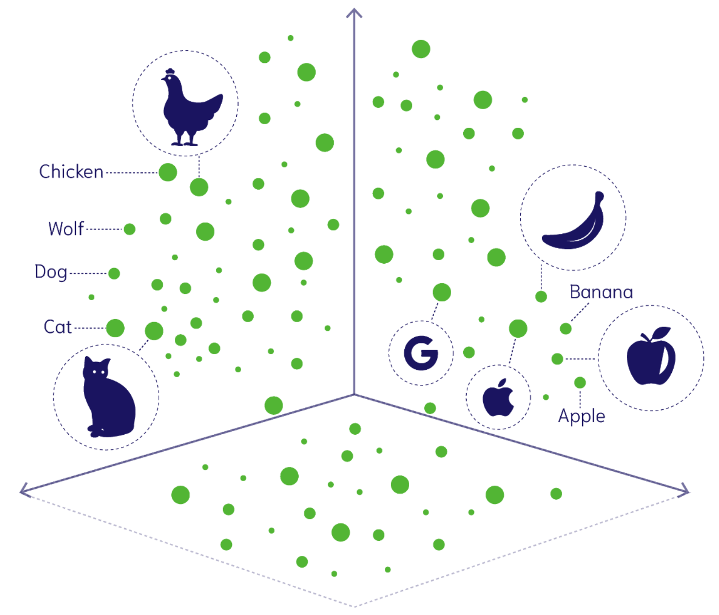
Multimodal Embeddings
Helps to preserve similarity across modalities.

Slide 6
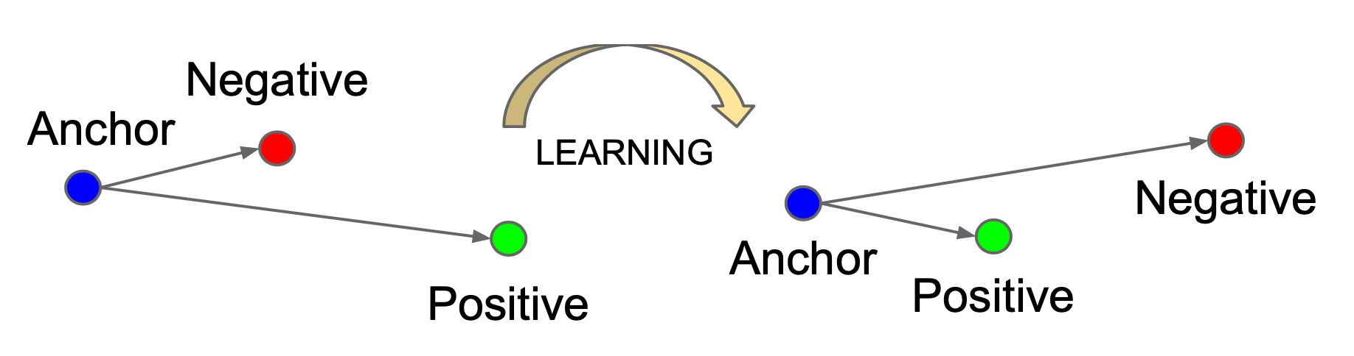
Contrastive Learning
Learn an embedding space in which similar vectors stay close using contrastive examples.

Slide 7
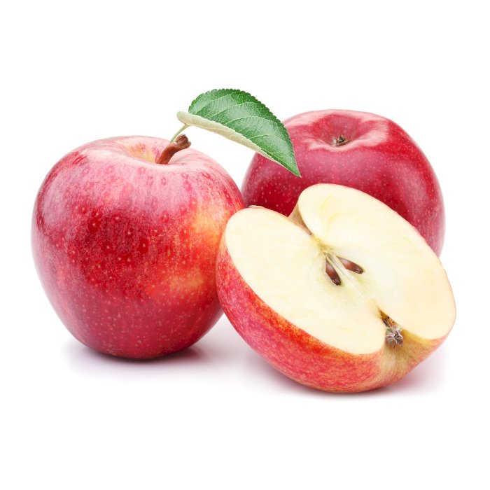
Contrastive Learning for Multimodality
Cat is a cute pet animal.

Slide 8
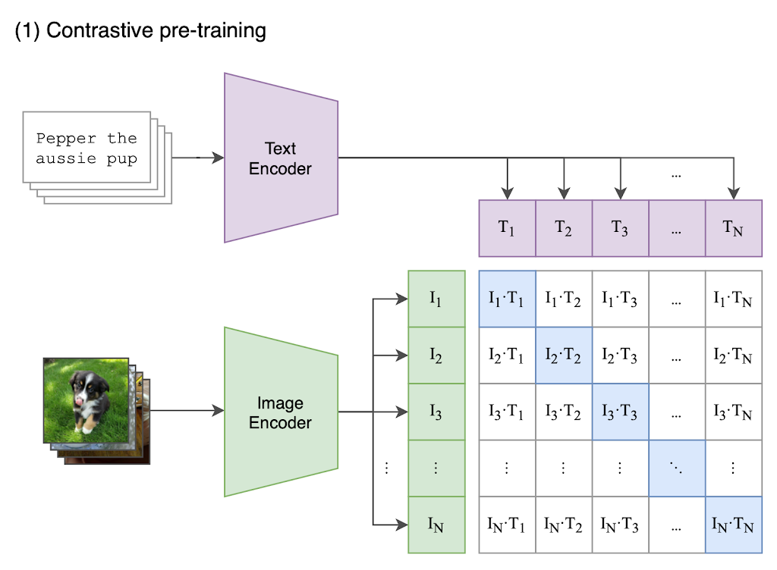
OpenAI - CLIP

Slide 9
Large Multimodal Model (LMM)

Slide 10
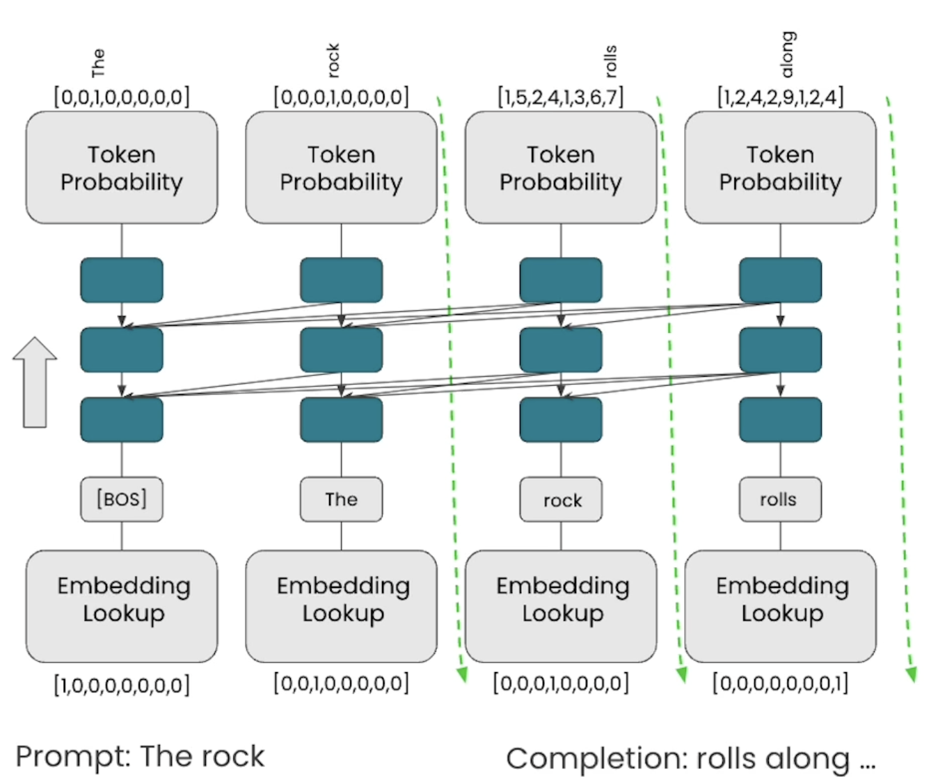
How GPT work?
Future tokens generated from probability distribution autoregressively - based on previous tokens.

Slide 11
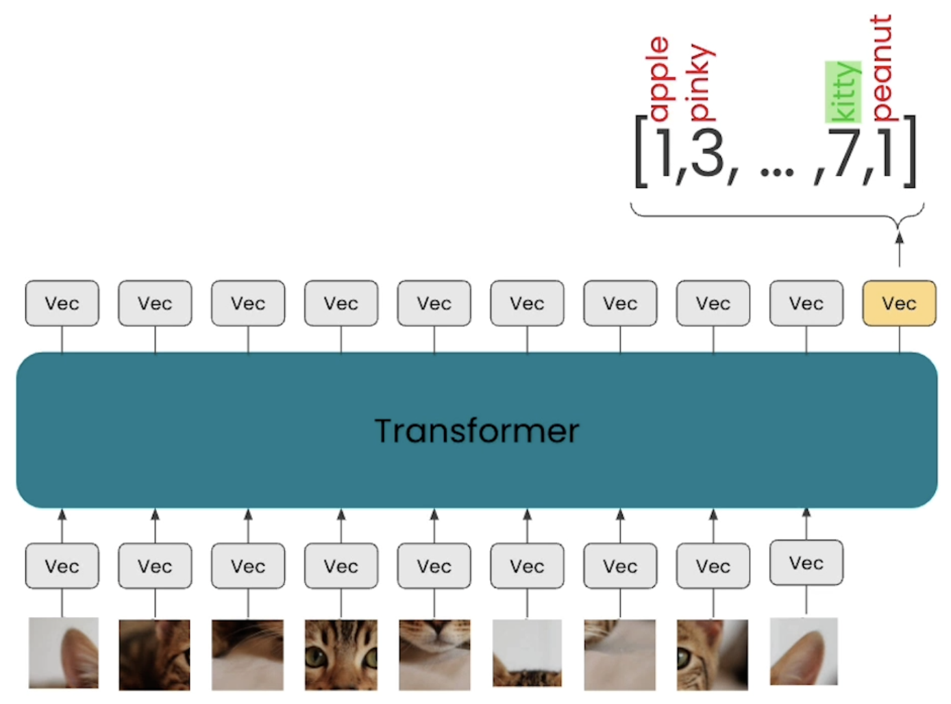
How ViT work?
Image patches are embedded and passed into transformer.

Slide 12
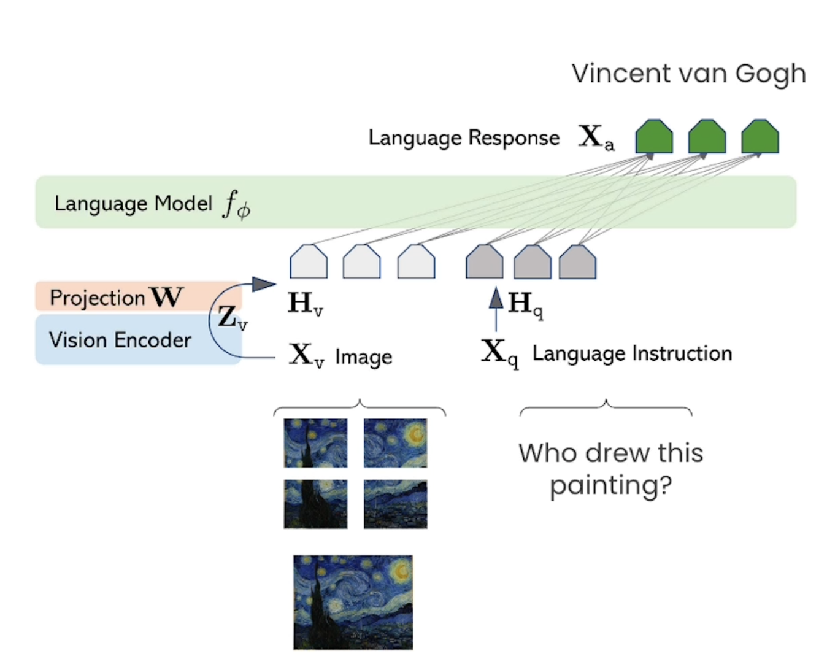
Visual Instruction Tuning

Slide 13
Multimodal RAG

Slide 14
Retrieval Augmented Generation (RAG), is a way to use external data or information to improve the accuracy of large language models.
RAG doesn’t train or fine-tune LLMs.

Slide 15
Brute force search | Approximate nearest neighbor
Provides exact best result | Fast search times, reduced storage requirements
Not practical with millions of items | Scalable to larger datasets
Real-time ranking difficult | Slightly reduced recall

Slide 16
Cloud Community
Day 2024
Thanks

